Slide 1
District Learning Day August 8, 2019
Notes:
Take a look! This is one of the official powerpoint templates for SCS. I will show the other two options later in the presentation.

Slide 2
Presenters
Marcia Faulhaber, White Station Elementary
Taryn Spake, Snowden Elementary
Kim Buie, Idlewild Elementary
Clerisa Smith, Campus School

Slide 3
NORMS
Focus: We have a lot to learn, so we all commit to focusing and being as present as possible. This work cannot wait.
Openness: We are all learning together, so we commit to being open with our successes and challenges, and with ideas and suggestions. It is safe not to know the answer.
Humility: The standards, shifts, and materials are still new for all of us, so we commit to being learners, even if the content isn’t completely new for us.
Support: Your learning is supported, so ask questions and ask for help.

Slide 4
SESSION OBJECTIVES
Know: What great titles are available to implement in your library program
Understand: How to choose titles based on interest and grade level, as well as how to choose a vendor to purchase titles.
Do: Examine the titles presented, provide feedback and create a list of titles that strengthens instruction and inspires students to read.

Slide 5
AGENDA
Introductions and read-aloud
Preview and share books
Provide vendor options
Identify other resources and helpful lists
Questions and feedback

Slide 6
Vendors
Junior Library Guild
Bound to Stay Bound
Perma-bound
Follet
Sebco
Others

Slide 7
Resources
Librarians
TASL (Tennessee Association of School Librarians) Conference in Murfreesboro, TN September 29- October 1
Workshops – DLD & Library PD
Webinars

Slide 8
QUESTIONS

Slide 9
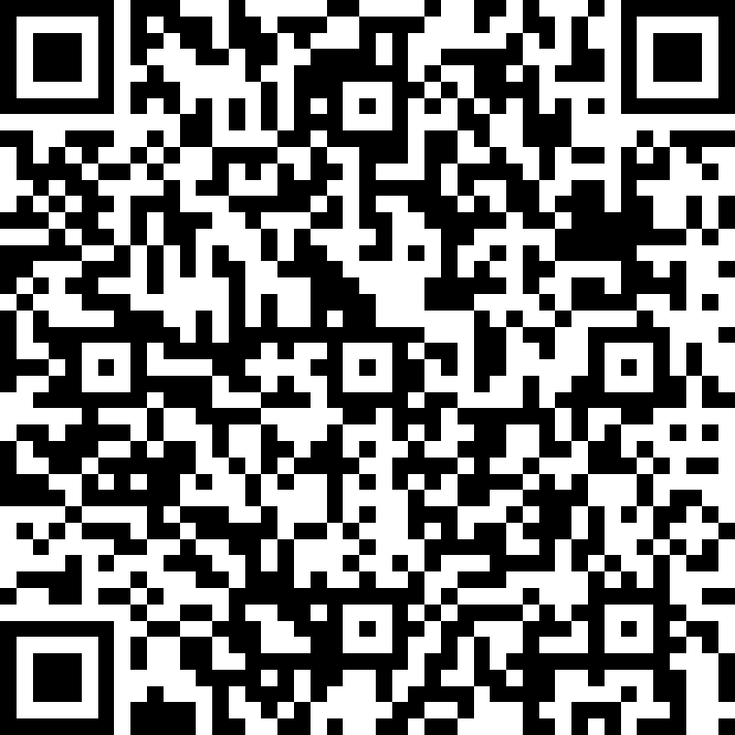
SURVEY
http://bit.ly/SCSAugust2019DLD

Slide 10
CONTACT INFORMATION
Marcia Faulhaber - faulhabermc@scsk12.org
Taryn Spake - spaketb@scsk12.org
Kim Buie - buiekd@scsk12.org
Clerisa Smith – clsmith3@memphis.edu

