Slide 1
District Learning Day January 3, 2019
Notes:
Take a look! This is one of the official powerpoint templates for SCS. I will show the other two options later in the presentation.

Slide 2
Moving Up: Moving beyond the middle school library curriculum
LaTarra Rallings
Media Specialist
Booker T Washington MS/HS

Slide 3
NORMS
Focus: We have a lot to learn, so we all commit to focusing and being as present as possible. This work cannot wait.
Openness: We are all learning together, so we commit to being open with our successes and challenges, and with ideas and suggestions. It is safe not to know the answer.
Humility: The standards, shifts, and materials are still new for all of us, so we commit to being learners, even if the content isn’t completely new for us.
Support: Your learning is supported, so ask questions and ask for help.

Slide 4
SESSION OBJECTIVE
Participants will learn the importance of the curriculum to prepare students to become skilled users of information, resources, and technology and use the curriculum as a guide for high school instruction.

Slide 5
AGENDA
Review and discuss Middle school curriculum by quarter
Sharing of resources for each quarter
AASL Standards “Quick Glance”

Slide 6
Middle School Library Curriculum
Designed to prepare students to become skilled users of information, resources, and technology
Supports the integration of information literacy and technology across all subject areas.
Divided into four quarters
Aligned to AASL standards and TN academic standards
Includes Literacy Events

Slide 7
Middle School High School
Because of flexible scheduling, the high school library-media curriculum is totally integrated with other curriculum subject areas.
High school librarians collaborate with all subject area teachers to implement the library-media curriculum.
High school library media specialists are encouraged to use the MS curriculum as an effective and useful guide to direct library media teaching and student learning.

Slide 8
AASL New Standards-Quick View
AASL Standards Learner Framework

Slide 9
Quarter 1 – The Research Process
LIBRARY SKILLS:
Library Orientation
Presentation Tools
Research Skills
Intellection Freedom

Slide 10
Quarter 1 – The Research Process
Orientation to high school library media center
Research Skills
Oral/written and visual process and presentation of research
Develop and use multimedia presentations effectively
Intellection Freedom

Slide 11
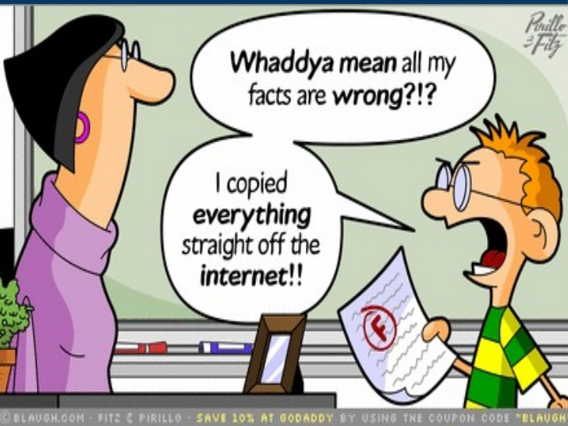
Quarter 2 – Information Resources
LIBRARY SKILLS:
Print Digital Resources
Academic Integrity
Evaluate Resources
Primary/Secondary Resources

Slide 12
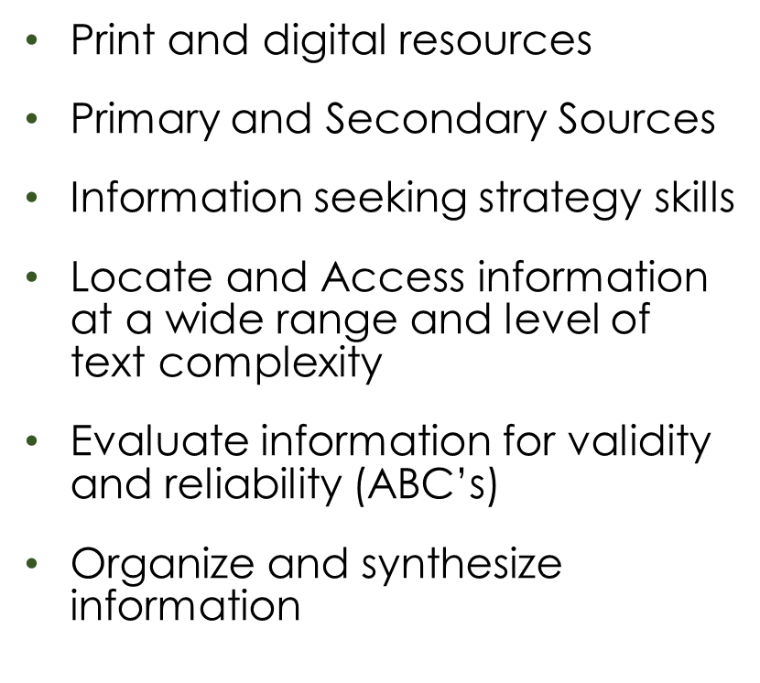
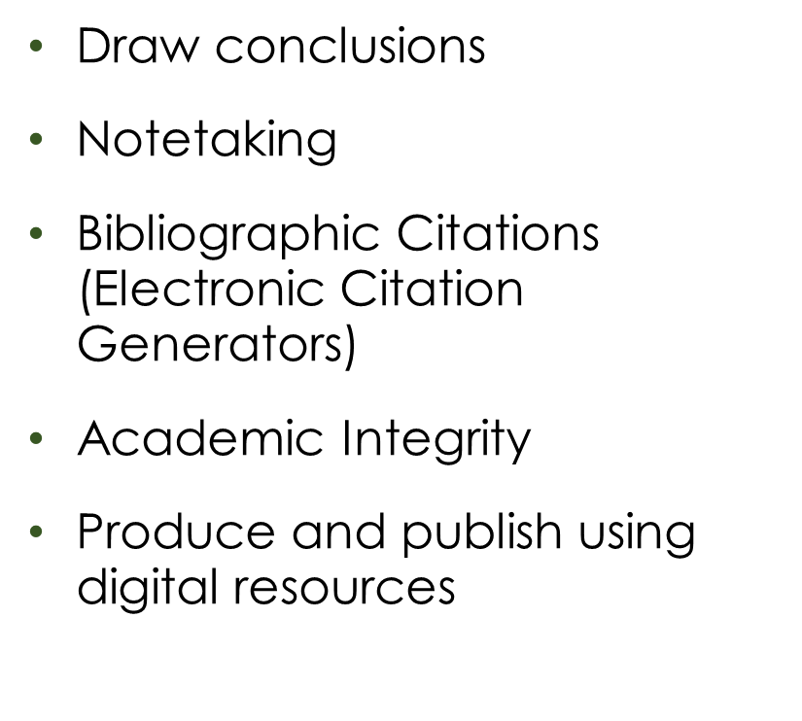
Quarter 2 – Information Resources

Slide 13
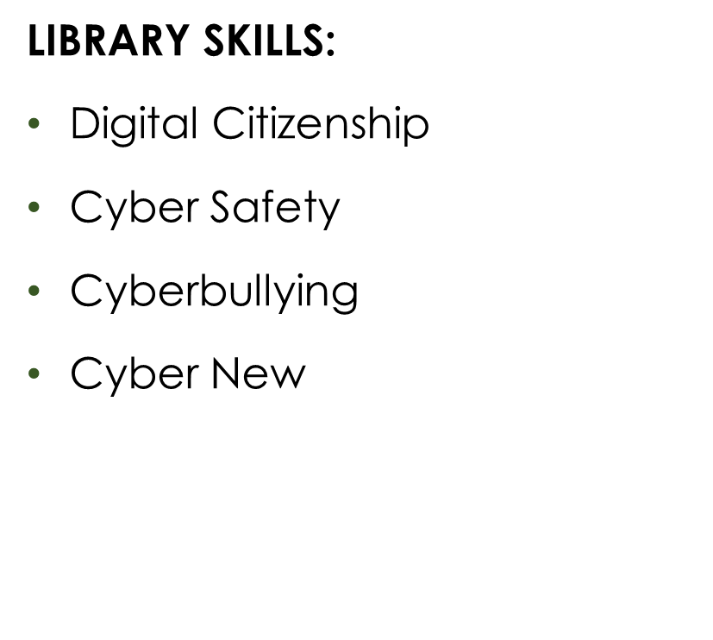
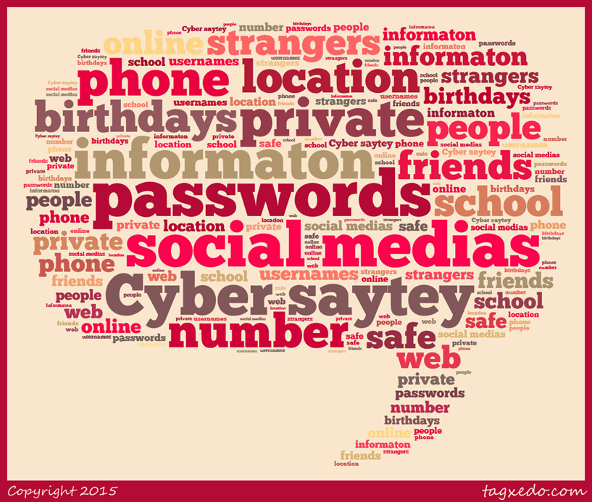
Quarter 3 – Cyber Awareness

Slide 14
Quarter 3 – Cyber Awareness
Acceptable Use Policy and social media guidelines
Use technology safely and responsibly
Digital Citizenship
I-Safe (High School)
Cyberbullying
Bias and misleading information (Cyber News)

Slide 15
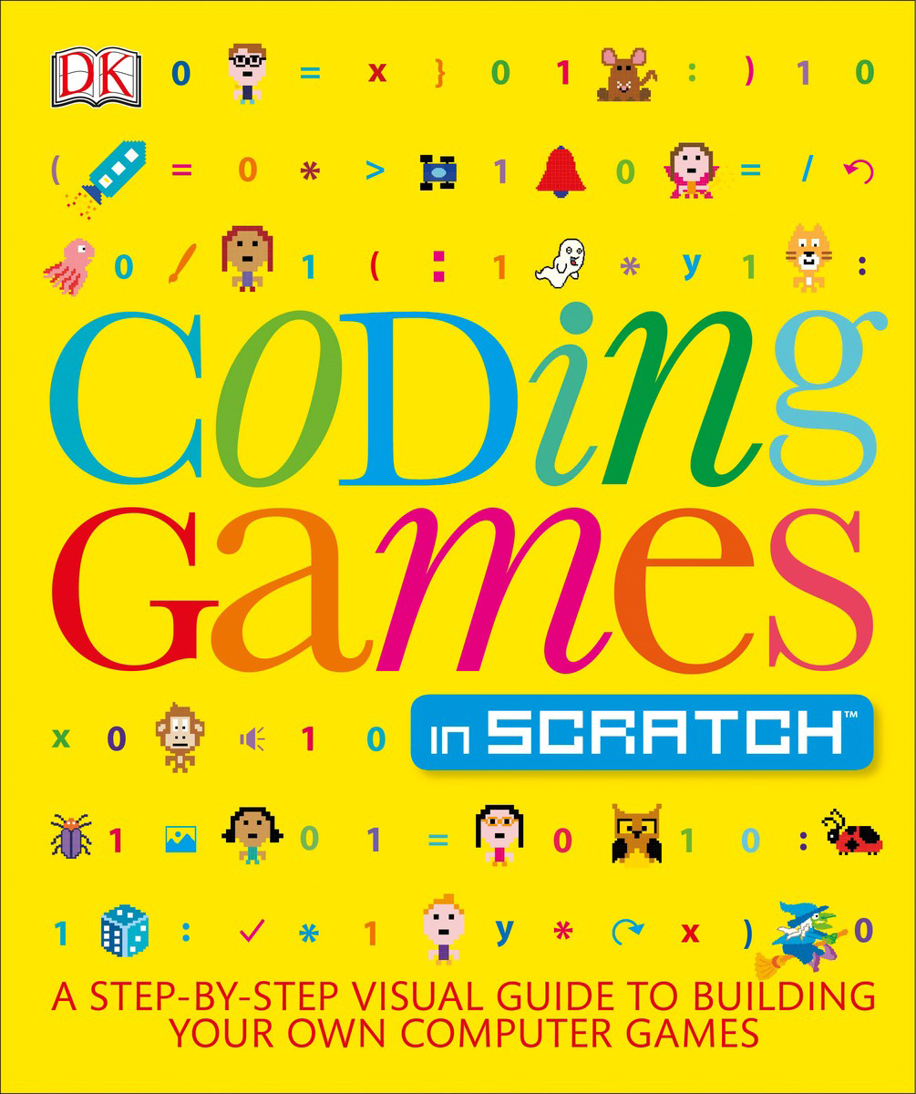
Quarter 4 – Digital Literacy

Slide 16
Activity – Gallery Walk
Rotate to each Quarter
List resources you have used for the Quarter
Rotate to the next Quarter at the end of the time period
A master list will be compiled and email to each librarian

Slide 17
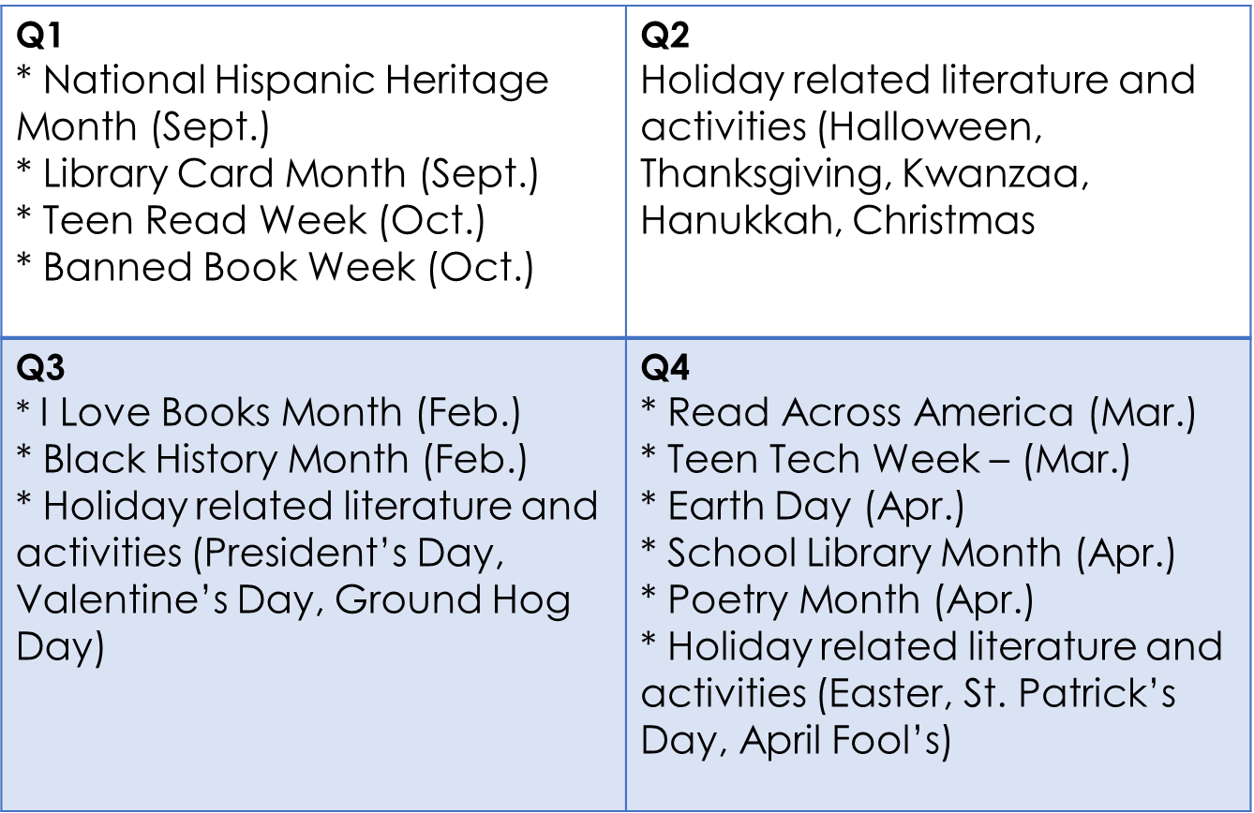
Literary Events

Slide 18
QUESTIONS

Slide 19
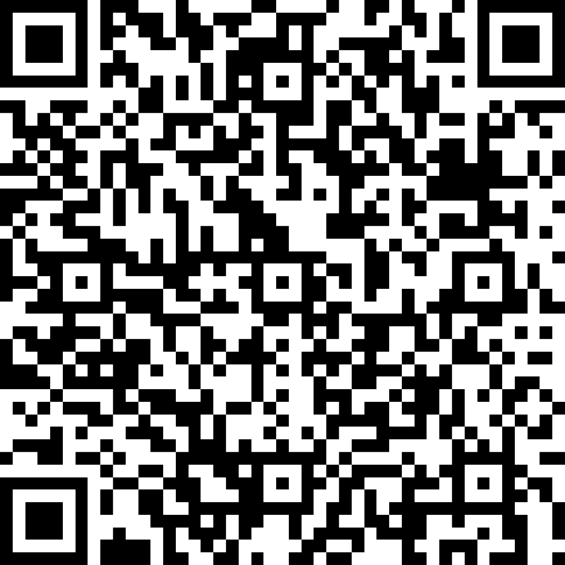
SURVEY
http://bit.ly/SCSAugust2019DLD

Slide 20
CONTACT INFORMATION
LaTarra Rallings
Media Specialist
Booker T Washington MS/HS
rallingsll@scsk12.org
901-416-7234

