Slide 1
District Learning Day August 8, 2019
Notes:
Take a look! This is one of the official powerpoint templates for SCS. I will show the other two options later in the presentation.

Slide 2
NORMS
Focus: We have a lot to learn, so we all commit to focusing and being as present as possible. This work cannot wait.
Openness: We are all learning together, so we commit to being open with our successes and challenges, and with ideas and suggestions. It is safe not to know the answer.
Humility: The standards, shifts, and materials are still new for all of us, so we commit to being learners, even if the content isn’t completely new for us.
Support: Your learning is supported, so ask questions and ask for help.

Slide 3
SESSION OBJECTIVES
Know:
Library programming should be used to promote literacy and to strengthen instruction in core content areas

Slide 4
SESSION OBJECTIVES
Understand:
Library programs must be implemented and promoted throughout the school year

Slide 5
SESSION OBJECTIVES
Do:
Discuss library programs that can be implemented for the first quarter
Create a programming plan for the first quarter

Slide 6
Library Routines & Procedures
STANDARD 3 – ENVIRONMENT: SPACE, RESOPURCES, AND ROUTINES
5.2 The LIS consistently ensures that the library media resources are available for all, with flexibility and creativity within or beyond the school day.
5.3 Circulation procedures have been established and have been implemented to maximize the use of library resources and have been communicated to all patrons.
5.4 Routines, procedures, and behavioral expectations are evident and consistent and create a culture of accountability for all patrons.

Slide 7
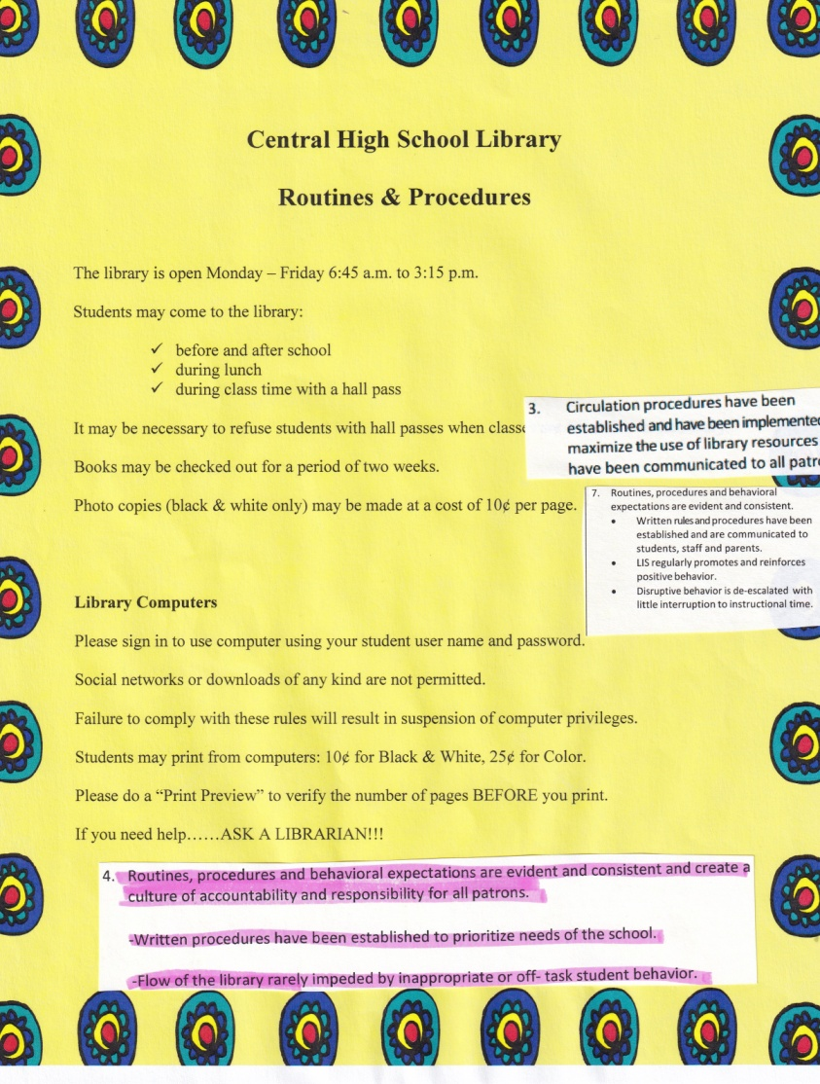
Library Routines & Procedures

Slide 8
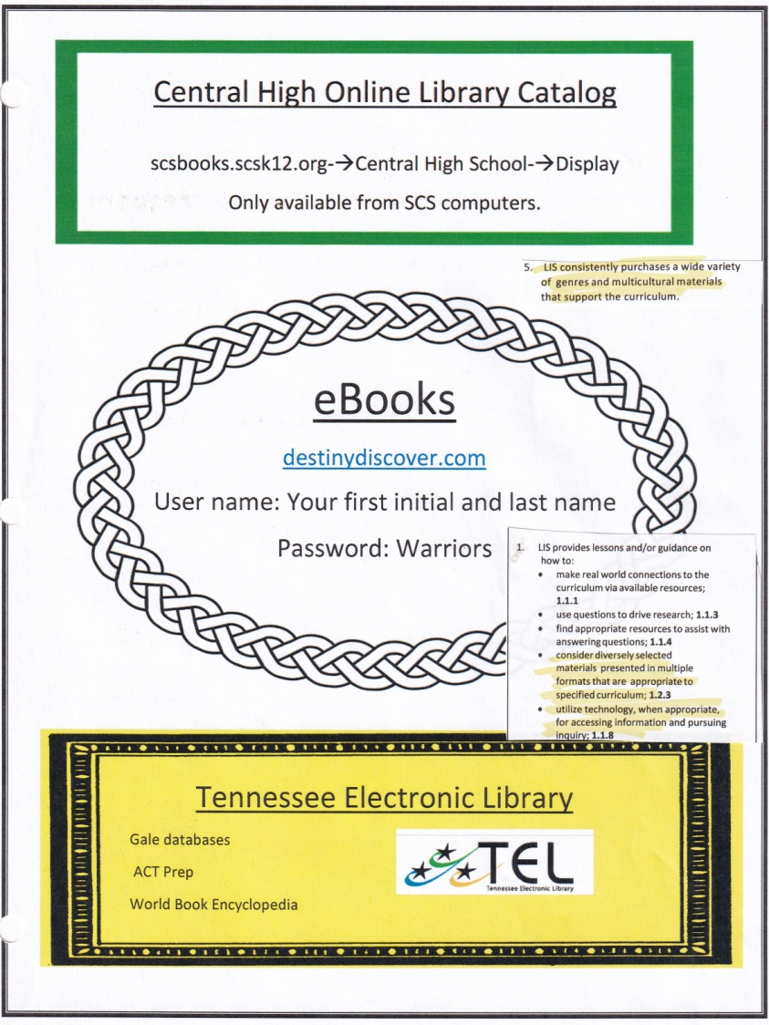
Library Routines & Procedures

Slide 9
Library Routines & Procedures

Slide 10
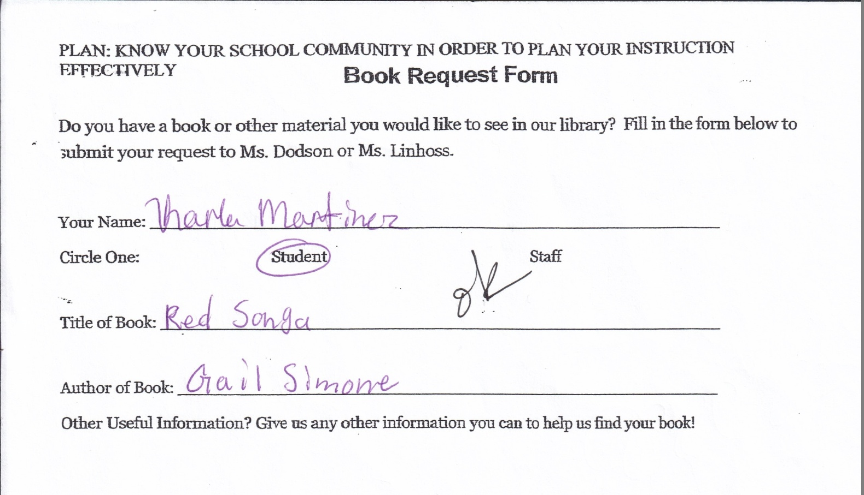
Library Routines & Procedures

Slide 11
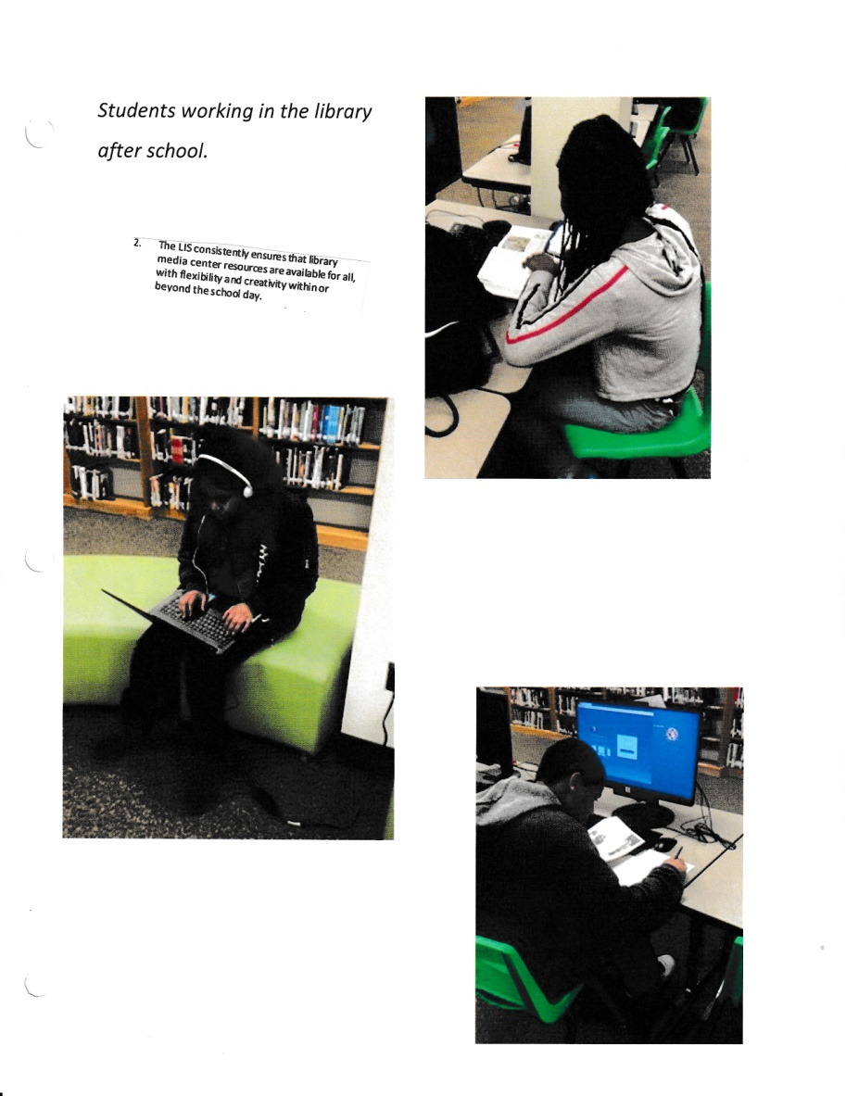
Library Routines & Procedures

Slide 12
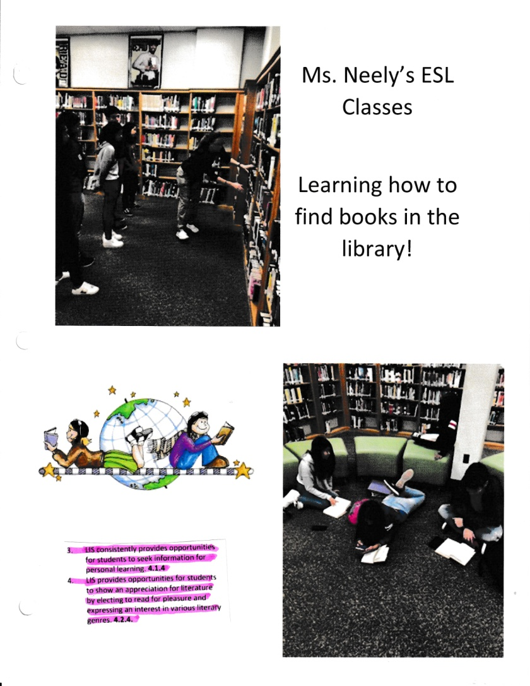
Library Routines & Procedures

Slide 13
QUESTIONS

Slide 14
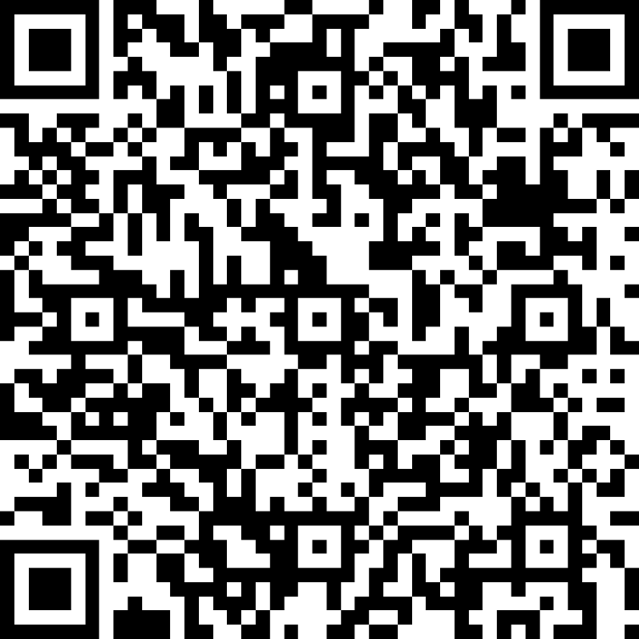
SURVEY
http://bit.ly/SCSAugust2019DLD

Slide 15
CONTACT INFORMATION
Debbie Dodson
Librarian
Central High School
(901) 416-3980
dodsondk@scsk12.org

