Slide 1
Librarians as Literacy Leaders
Susan Harris, librarian, Ridgeway High
District Learning Day
Thursday, August 3, 2017
Notes:
Welcome!
Introduce selves…

Slide 2
GROUP NORMS
Take responsibility for yourself as a learner.
Honor timeframes (start, end, activity).
Be an active and hands-on learner.
Use technology to enhance learning.
Strive for equity of voice.
Contribute to a learning environment where it is “safe to not know.”
Ask questions tactfully if you don’t see the relevance.
Notes:
All session use these norms….
Before we get started, let’s review the norms of how we will work together today:
Take responsibility for yourself as a learner.
Honor timeframes (start, end, activity).
Be an active and hands-on learner.
Use technology to enhance learning.
Strive for equity of voice.
Contribute to a learning environment where it is “safe to not know.”
Ask questions tactfully if you don’t see the relevance.

Slide 3
Curriculum Connection​
The library activities in this presentation encourage students to read with comprehension which supports the following TN ELA Reading standards:​
​
TN READING STANDARD 10 (R.RRTC.10)
Range of reading and level of text complexity
​
10.RL.RRTC.10
Read and comprehend a variety of literature at the high end of the grades 9-10 text complexity band independently and proficiently.
10.RI.RRTC.10
Read and comprehend a variety of literary nonfiction at the high end of the grades 9-10 text complexity band independently and proficiently.
12.RL.RRTC.10
Read and comprehend a variety of literature at the high end of the
grades 11-12 text complexity band independently and proficiently.
12.RI.RRTC.10
Read and comprehend a variety of literary nonfiction at the high end of the grades 11-12 text complexity band independently and proficiently.
​
​
Notes:
Place your KUDOS here

Slide 4
Objectives
Participants will know how to make their school library a 21st century community learning center (ESSA-Every Student Succeeds Act).
Participants will understand how to personalize learning using reading comprehension strategies.
As a result of this presentation, participants will be able to coteach with classroom teachers applying the specific reading comprehension strategies of activating/building prior knowledge, using sensory images, questioning, making predictions and inferences, determining main ideas and using “fix-up” strategies.
Notes:
Place your KUDOS here

Slide 5
Agenda
Vision
The vision for this session is for librarians to
become literacy leaders at their schools.
Notes:
Use this format for your agenda

Slide 6
Notes:
All sessions include the next set of slides in the vision section of the agenda
Destination 2025 is our end goal, but it’s not our vision…
First, let’s look at the Chief of Schools’ vision…

Slide 7
Chief of Schools Vision
Our Vision for Student Success Every day, Shelby County School students experience high levels of success with challenging content in our classrooms and show consistent academic growth and achievement each year. We are committed to preparing well-rounded graduates who compete globally, because they persevere through challenges, think critically, advocate for and drive their own learning experiences, and collaborate effectively with diverse peers.
Notes:
All sessions include the next set of slides in the vision section of the agenda
Read the COS vision

Slide 8
Vision and Key Levers
Our key levers represent HOW we will get there, the commitments that we will make and where we will focus our time, our resources, and our capacity.
If we… | Act as a collaborative service that provides intentional support to every school
And if we | Leverage the strengths and talents of our people
And if we | Invest all stakeholders in our vision and strategies for student success
And if we | Equip all leaders to be agents of change
And if we | Foster a dynamic, coherent instructional system to support and develop our schools in achieving our shared vision.
Then… | Principals will create conditions, structures, and supports that foster an intentional culture of teaching and learning which meets the academic, social, and emotional needs of students. Teachers will meet the academic, emotional and social needs of students by using high-yield practices and resources to craft instructional experiences that accelerate student growth and achievement. Students will experience optimal learning environments which will allow them to think critically, collaborate with peers and demonstrate learning expectations.
Notes:
All sessions include the next set of slides in the vision section of the agenda
Our key levers, or our theory of action, is the framing of how we will achieve our vision and associated end state: Destination 2025

Slide 9
Chief of Schools Department Priorities
PRIORITIES:
Support all schools in their implementation of improvement strategies (human capital, extended day, coaching leaders concerning Tennessee State standards)
Develop educators by providing quality professional development for all leaders (ILDs, ILTs, ISW week, principals, assistant principals, and PLC Coaches)
Build capacity by implementing and building Instructional Leadership Teams in all schools
Define clear roles and responsibilities in all schools to ensure alignment of strategies (leaders, coaches, teacher leaders)
Utilize data and technology to support improvement
Build a pipeline of effective leaders to support all schools (principal and teacher leaders)
Establish “non-negotiables” for all schools to increase the achievement of students
Notes:
All sessions include the next set of slides in the vision section of the agenda
In this last section of the vision, we need to quickly review the priorities – here’s what we will specifically focus on to ensure the key levers are activated.
As a District, this is the work for 2017-18, but now, let’s drill down to the specific work as it relates (insert your subject here…)

Slide 10
Context for presentation
Coteaching Reading Comprehension Strategies in Secondary School Libraries Maximizing Your Impact by Judi Moreillon and Mosaic of Thought by Ellin Oliver Keane and Susan Zimmermann are two texts from which this presentation was generated.
This material is adapted from Leadership in Literacy Instruction, a six-week PD course offered through MTSU and instructed by Karen Reed, educational librarian, MTSU.
According to Douglas Achterman (2008), “Research has shown a positive correlation between increased student achievement and school librarians and classroom teachers who engage in coplanning and coteaching.”

Slide 11
“Activating and Building Prior Knowledge”
How do we teach activating and building prior knowledge as a reading comprehension strategy?
Think about how reading is a transaction between the reader, the text and the intentions of the author.
For this reason, we must connect new information to prior knowledge before we can integrate and organize new information. Educators must determine what students already know or think they know before introducing a new topic. How can we do this?

Slide 12
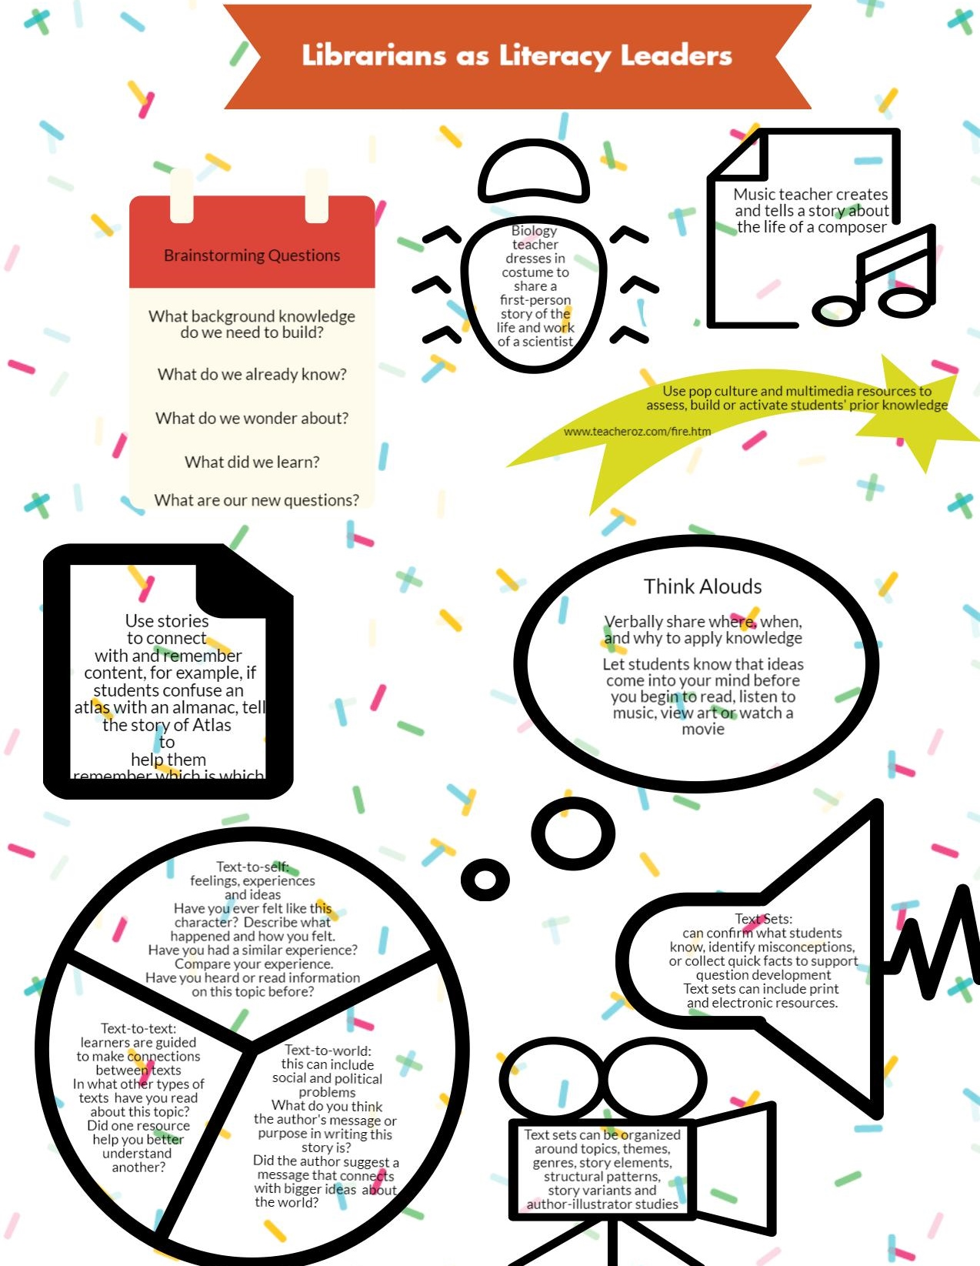

Slide 13
Airtight Activity: MODELING
MODEL text-to-text, text-to-self, text-to-world connections (think alouds), use KWL or BKWLQ (needed background knowledge and new questions) charts and graphic organizers, use Twiddla to complete a matrix, use notemaking for students to record connections, information and questions in their own words
Check for understanding
Give explicit instructions
Ask for feedback

Slide 14
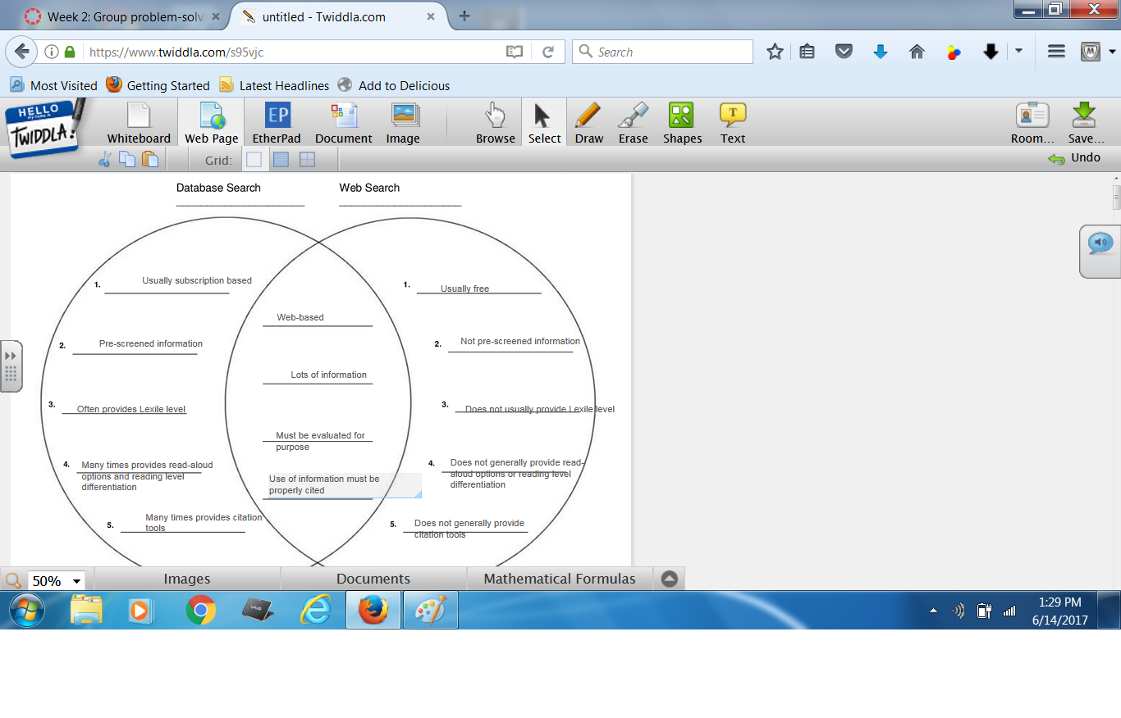

Slide 15
“Using Sensory Images”
“How do we teach using sensory images as a reading comprehension strategy?”
“We take in more information visually than through any of the other senses.” (Wolfe 2001)
Doug Buehl (2013) states, “Proficient readers use visual, auditory, and other sensory connections to create mental images of an author’s message.” How can we teach our students to use these connections?

Slide 16
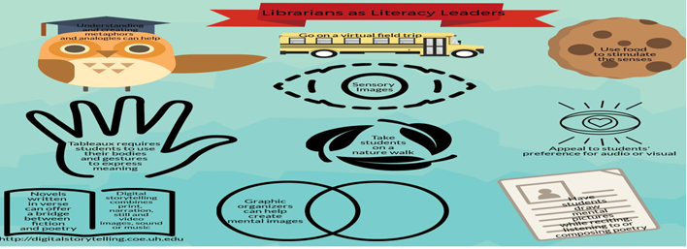

Slide 17
Airtight Activity: Modeling
Use graphic organizers, model reading aloud and asking students to close their eyes and visualize the imagery in the text, use digital storytelling and graphic novels, use Canva to create a poster
Check for understanding
Give explicit instructions
Have participants give feedback
Notes:
Click to add notes

Slide 19
“Questioning”
How do we teach questioning as a reading comprehension strategy?
Questions propel meaning making before, during and after reading. Questioning keeps readers engaged with texts and guides their reading and learning. Questions establish a purpose for reading. How can we guide our students to ask higher order questions?

Slide 21
Airtight Activity: Modeling
Model reading a text and completing a QAR matrix (can use Google Docs as a group), talk about “on the line,” “between the lines” and unanswered questions, model the thinking that follows “I wonder” (“5 Ws”)
Check for understanding
Give explicit instructions
Have participants give feedback

Slide 22
Before Reading
Who? | Who is Clare Vanderpool, the author and the person? (***Conduct research or **if the student already knows who Clare Vanderpool is.)
What? | What does the word, “navigating,” mean in the title, Navigating Early? (***Conduct research or **if the student already knows the meaning of this word.)
Where? | Where does this story take place? (* “We’d flown to Maine a few hours earlier on a military cargo plane.”)
When? | When was this story written? When did this story take place in history? (***Conduct research.)
Why? | Why did Clare Vanderpool write this story? (***Conduct research.) Why was our country at war at the time in which this story took place? (***Conduct research.)
How? | How does this book relate to me, the world in which I live or something else I have read? (**The student must connect information from the book with his/her own background knowledge.)
*Answered “on the line” (in the text in one passage or by connecting information from various parts of the text)
**Answered “between the lines” (by connecting information with own background knowledge)
***Unanswered questions (may require evaluation or further research)
From J. Moreillon, Coteaching Reading Comprehension Strategies in Secondary School Libraries (Chicago: American Library Association, 2012). Licensed under the Creative Commons
Attribution–Noncommercial–Share Alike 2.5 License: http://creativecommons.org/licenses/by-nc-sa/2.5/.

Slide 23
“Making Predictions and Inferences”
How do we teach prediction and inference as reading comprehension strategies?
Predictions are educated guesses about what will happen next in the text based on what is known from reading the text and from activated background knowledge.
Inferences require readers to go beyond literal meaning and use print, illustrations and activated background knowledge to interpret the text; inferences are never answered directly in the text.
How do we teach our students to use these strategies?

Slide 24
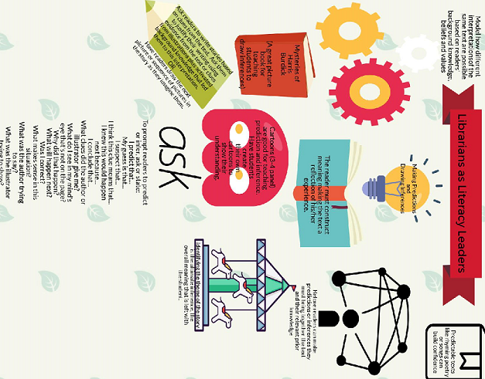

Slide 25
Airtight Activity: Modeling
Model the use of Strip Generator, model thinking aloud after reading the title of the book and looking at the cover, model thinking aloud as you read and look at illustrations, model using graphic organizers to have students record their thinking
Check for understanding (predictions are educated guesses about what will happen next based on what is known from reading the text; inferences allow the reader to make his/her own meanings based on limited clues in the text)
Give explicit instructions
Have participants give feedback

Slide 26
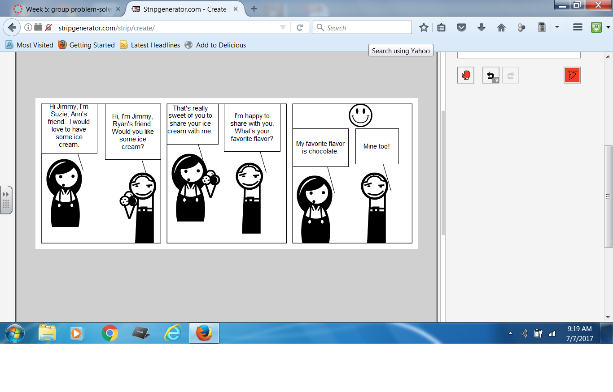

Slide 27
“Determining Main Idea”
How do we teach determining main idea as a reading comprehension strategy?
“Information is only a set of facts until someone determines its importance, internalizes it, and turns it into knowledge through use.” (Moreillon 2012)
“Main ideas are always dependent on the purpose for reading.” (Moreillon 2012)
“Main ideas are the foundation on which the details rest.” (Moreillon 2012)
How do we teach our students the strategy of determining the main idea(s)?

Slide 28
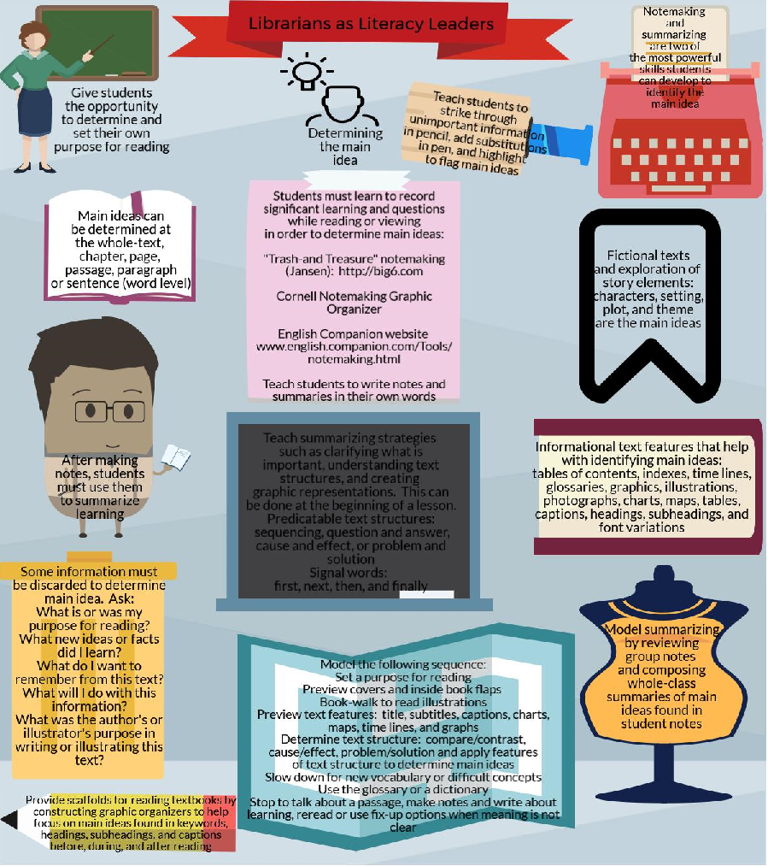

Slide 29
Airtight Activity: Modeling
Model how to determine the main idea and invite students to make judgments about which ideas are most important and which are less important, give students clear purpose for reading, teach the use of text features and text structure to determine main idea(s), use think-alouds to demonstrate how to distill the main ideas from a passage and show students the process for recording notes that reflect what is learned
Check for understanding
Give explicit instructions
Have participants give feedback

Slide 30
“Fix-Up Options”
How do we teach fix-up options as a reading comprehension strategy?
Elaine McEwan states, “The difference between proficient and striving readers is their awareness of when they lose comprehension and how they respond to it when they do.”
How can we teach students to fix-up their reading comprehension?

Slide 32
Airtight Activity: Modeling
Model the strategies of rereading, reading ahead, or figuring out unknown words, teach students when they are no longer making connections, they should suspect they have lost the thread of meaning, show the video: “Fix-Up Options: Read the Signs!” https://animoto.com/play/W1Jb61RviJIcd70IfYY5zA,
demonstrate how to chunk informational texts
Check for understanding
Give explicit instructions
Have participants give feedback

Slide 33
Reflection:
What resonated with you?
What is similar to your current practice?
What is different than your current practice?
What are you going to change as a result?

Slide 34
Reflection: Application
What was easiest for you?
What was most difficult?
What else do you need to learn/do prior to applying to your classroom?

Slide 35
Reflection: One minute paper on post-it
Jot down your “Take-Aways”
Consider what you need to know and be able to do to successfully implement what you have learned in this session.
What is still unclear?
What professional development or additional resources do you need?

Slide 36
Closing
Reading comprehension is making meaning from texts.
Please share your favorite reading comprehension strategy discussed today, why it is your favorite and how you can assess the success of this strategy in your classroom.

Slide 37
Next steps and activities for follow up
All participants are asked to create and share a “Choose Your Own Adventure” lesson plan that aligns with one or more of the strategies presented today. (Karen Reed, MTSU.)
All participants are asked to create and share a text set.

Slide 38
Questions

