Slide 1
Equipping Library Information Specialists for Destination 2025 August 8, 2019 Presented by April Frase and Nevenia Hill
Notes:
Take a look! This is one of the official powerpoint templates for SCS. I will show the other two options later in the presentation.

Slide 2
NORMS
Focus: We have a lot to learn, so we all commit to focusing and being as present as possible. This work cannot wait.
Openness: We are all learning together, so we commit to being open with our successes and challenges, and with ideas and suggestions. It is safe not to know the answer.
Humility: The standards, shifts, and materials are still new for all of us, so we commit to being learners, even if the content isn’t completely new for us.
Support: Your learning is supported, so ask questions and ask for help.

Slide 3
SESSION OBJECTIVES
Participants will:
Learn the importance of sound librarianship and its connection in the promotion of literacy
Understand the TEM LIS Rubric as it applies to instruction, environment and professionalism
Learn how to use some of the basic features of the Atriuum Library Management System

Slide 4
AGENDA
Review and discuss:
Librarianship expectations
Training and professional development opportunities
The Library Information Specialist TEM rubric and process
Basic functions of Atriuum
Library organization, management, and environment
Literacy promotion

Slide 5
What Does Librarianship Mean?
The ALA gives the following definition for librarianship:
“The foundation of modern librarianship rests on an essential set of core values that define, inform, and guide our professional practice.”

Slide 6
Librarianship
Professionalism
Library and Collection
Promotion of Literacy

Slide 7
Professionalism
The conduct, aims or qualities that characterize or make a profession or a professional person. A level of excellence or competence that is expected.

Slide 8
Presentation
Library
Attire
Approachable
Positive
Competent

Slide 9
Training and Professional Development
Attend PD
Implement PD

Slide 10
TEM Evaluation
Number of Evaluations
Use of LIS Rubric
Collaboration with Administrator prior to evaluation
Collection of evidence
Standards

Slide 11
Atriuum Library Management System
scsbooks.scsk12.org
Log on and log off
Checking in and checking out
Searching OPAC

Slide 12
Organization and Library Management
Routines and Procedures
Time Management
Library Plan
Library Handbook
Promotional Calendar
Curriculum Map
Portfolio

Slide 13
Library Environment and Organization
Is the library inviting?
Is the library orderly?
Are library materials accessible to all?
Is the signage clear?

Slide 14
Promotion of Literacy
Interact with students
Read aloud to students when possible
Participate in promotional programs (Read for the Record; Read Across America; book fairs; book club; self-created promotional activities)

Slide 15
Shelby County Schools Library Procedure Manual
Shelby County Schools Library Procedure Manual

Slide 16
QUESTIONS

Slide 17
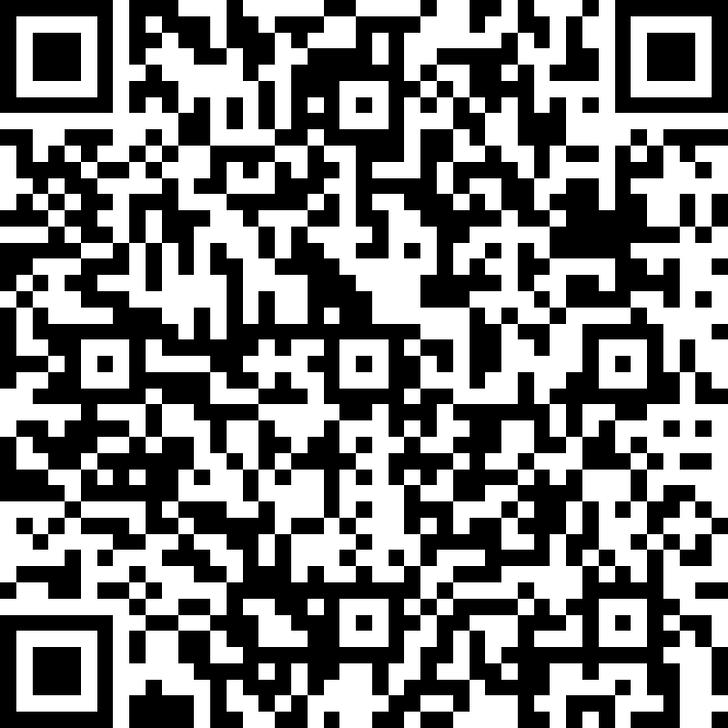
SURVEY
http://bit.ly/SCSAugust2019DLD

Slide 18
CONTACT INFORMATION
April Frase wilsonar@scsk12.org
Nevenia Hill hillna@scsk12.org
Library Services Department
416-5382

